Slide 1

19CS2109
Computer Networks And Security
Elements of Transport Protocols

Slide 2
Elements of Transport Protocols
Addressing
Connection Establishment
Connection Release
Flow Control and Buffering
Multiplexing
Crash Recovery

Slide 3
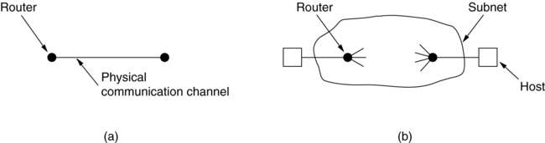
Transport Protocol
(a) Environment of the data link layer.
(b) Environment of the transport layer.

Slide 4
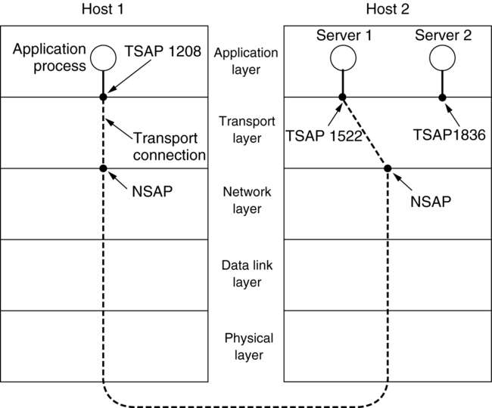
Addressing
TSAPs, NSAPs and transport connections.

Slide 5
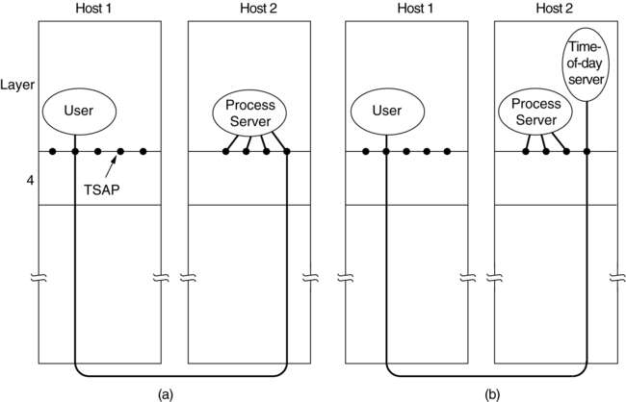
Connection Establishment
How a user process in host 1 establishes a connection with a time-of-day server in host 2.

Slide 6
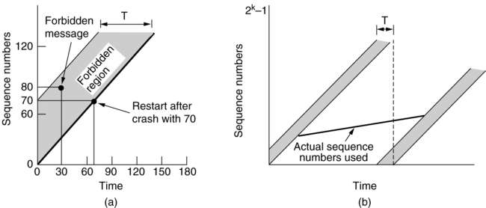
Connection Establishment (2)
(a) TPDUs may not enter the forbidden region.
(b) The resynchronization problem.

Slide 7
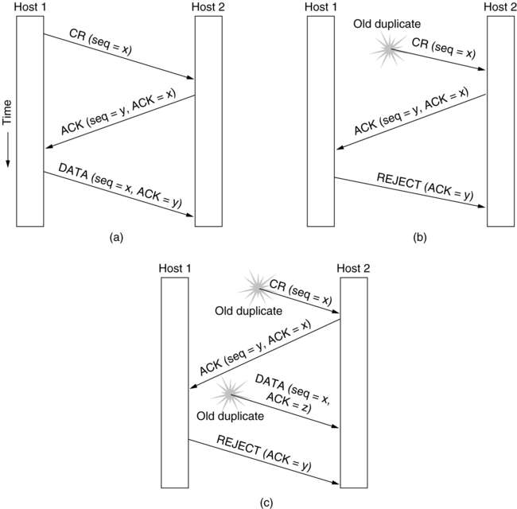
Connection Establishment (3)
Three protocol scenarios for establishing a connection using a three-way handshake. CR denotes CONNECTION REQUEST. (a) Normal operation, (b) Old CONNECTION REQUEST appearing out of nowhere. (c) Duplicate CONNECTION REQUEST and duplicate ACK.

Slide 8
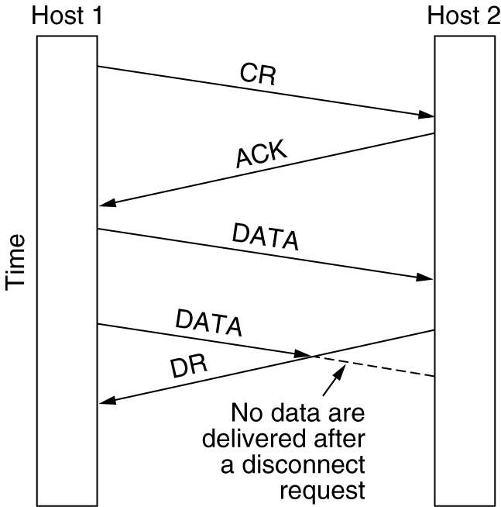
Connection Release
Abrupt disconnection with loss of data.

Slide 9
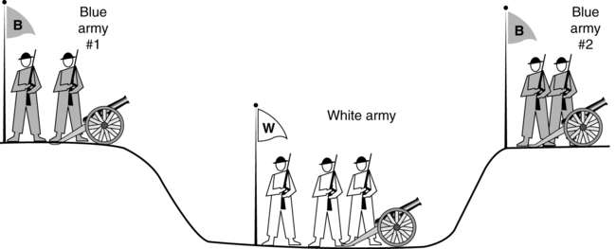
Connection Release (2)
The two-army problem.

Slide 10
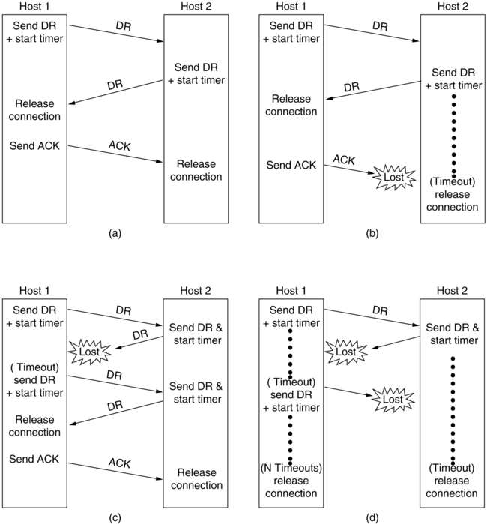
Connection Release (3)
Four protocol scenarios for releasing a connection. (a) Normal case of a three-way handshake. (b) final ACK lost.
6-14, a, b

Slide 11
Connection Release (4)
6-14, c,d
(c) Response lost. (d) Response lost and subsequent DRs lost.

Slide 12
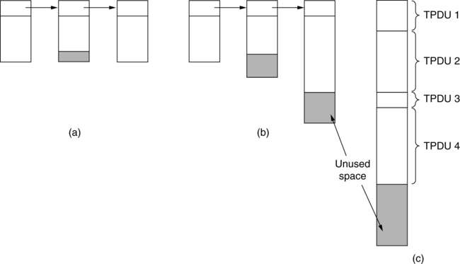
Flow Control and Buffering
(a) Chained fixed-size buffers. (b) Chained variable-sized buffers. (c) One large circular buffer per connection.

Slide 13
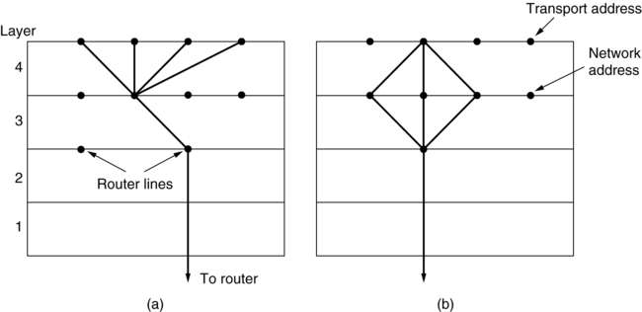
Multiplexing
(a) Upward multiplexing. (b) Downward multiplexing.

Slide 14
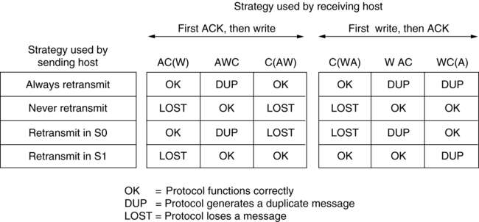
Crash Recovery
Different combinations of client and server strategy.

